Slide 1

AUTOMOV
Subject Name: IP Project (CS203)
Submitted By:
1. ARUSH GUPTA(2010991493)
2. DAMIA KALRA(2010991526)
3. GAUTAM NARULA(2010990233)
4. KARTIKAY SHARMA(2010991590)
Department of Computer Science and Engineering
Chitkara University, Punjab

Slide 2
AUTOMOV’S APPROACH
High Level Approach Automov’s website is designed to be user-friendly and informative. The homepage showcases the image of one of Automov's vehicles, as well as overview of the company’s products. Automov's website allows visitors to learn more about its products. Visitors can view detailed specifications for each vehicle, as well as read reviews from other customers. Automov allows customers to book or purchase vehicles online and also allow them to schedule vehicle service. | Low Level Approach The website is responsive, which means that it can be viewed on a variety of devices, including desktop computers, laptops, tablets, and smartphones. The Autmov’s website is secure, which means that visitors' personal information is safe when they make a purchase or contact customer support. The website is optimized for search engines, which means that it is more likely to be found by potential customers when they search for information about our products or services.

Slide 3
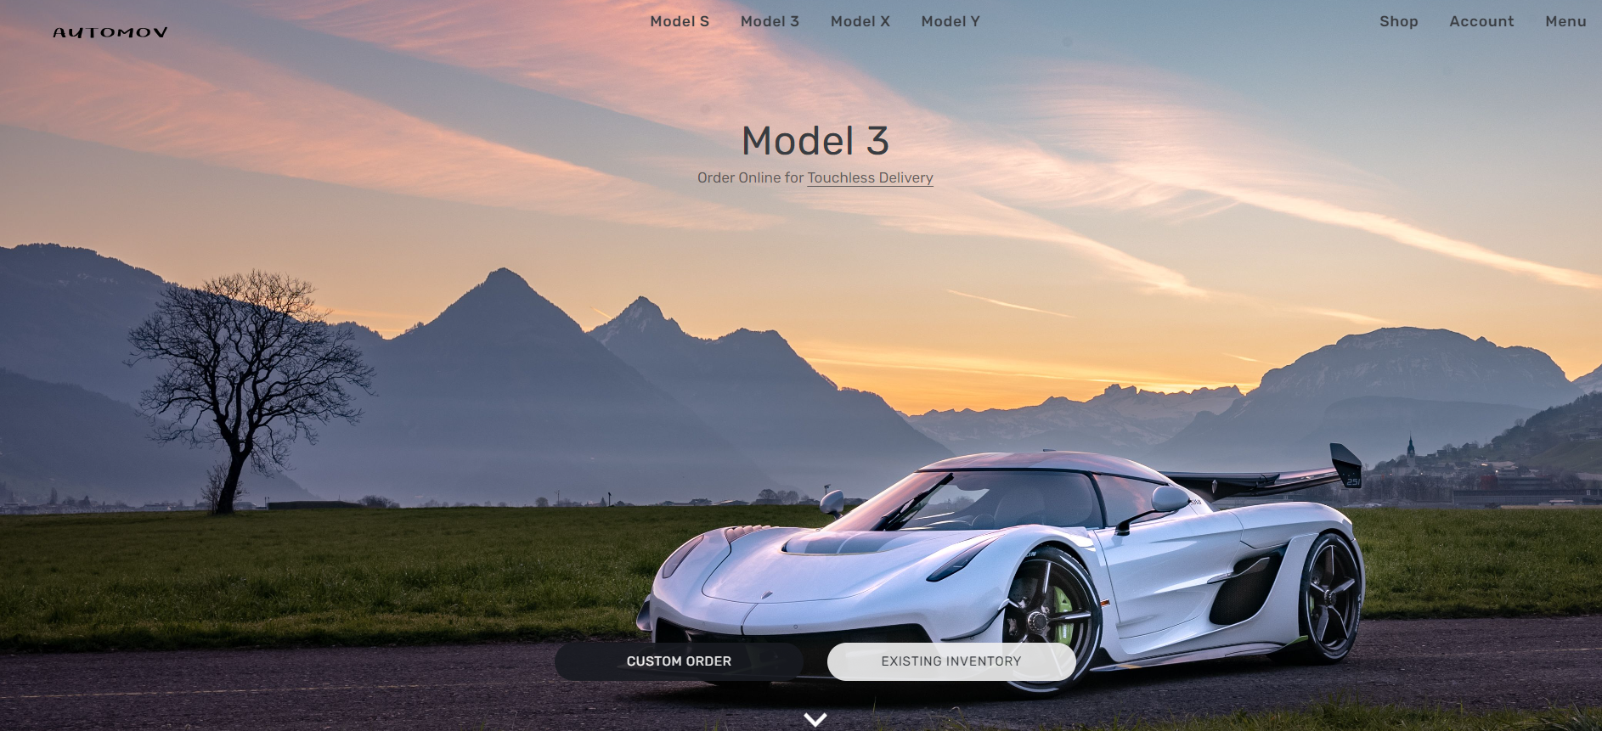
INDEX PAGE
This the very first page of the website. It tells a bit about what is offered by Automov.
There is an image hanging with the help of CSS animation effect. There is a button “menu” which directs the user to the next login page.
The user can subscribe with his/her email id to avail a VIP treatment while being on this website for purchases.
Also, the user has an option to ask questions, if any by filling the form placed at bottom left corner.
The contact information is also available towards bottom right corner. The whole concept is build via html form and CSS concepts using JSX(React).

Slide 4
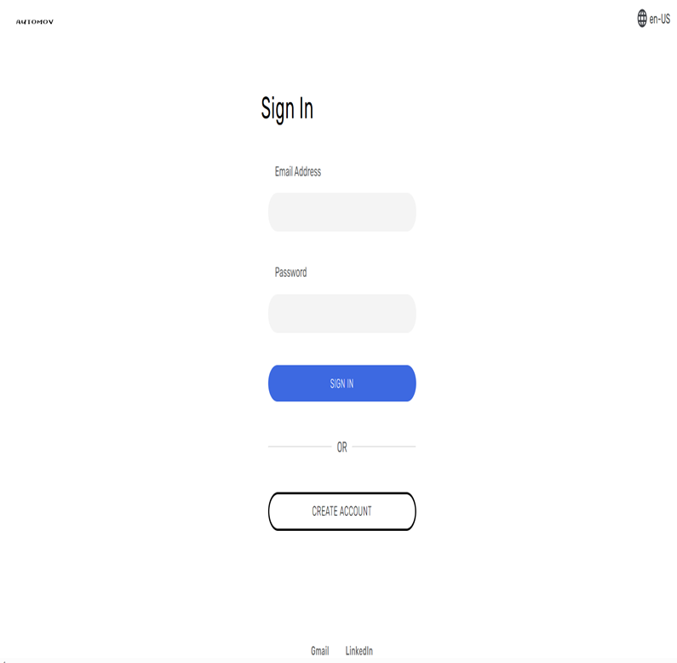
LOGIN PAGE
This is the Login Page where the user is asked to enter his/her username and password.
After adding both username and password and then clicking the “Login” button, the user will be directed to the next Home Page.
If the username is not found the alert message is poped up displaying “auth/invalid-emailFirebase: Error (auth/invalid-email)”.
In case a wrong password is entered alert message with “wrong password” is popped up.
The image inserted above is the logo of the website. This page is designed using HTML form in JSX and various CSS concepts colors and buttons wherever necessary

Slide 5
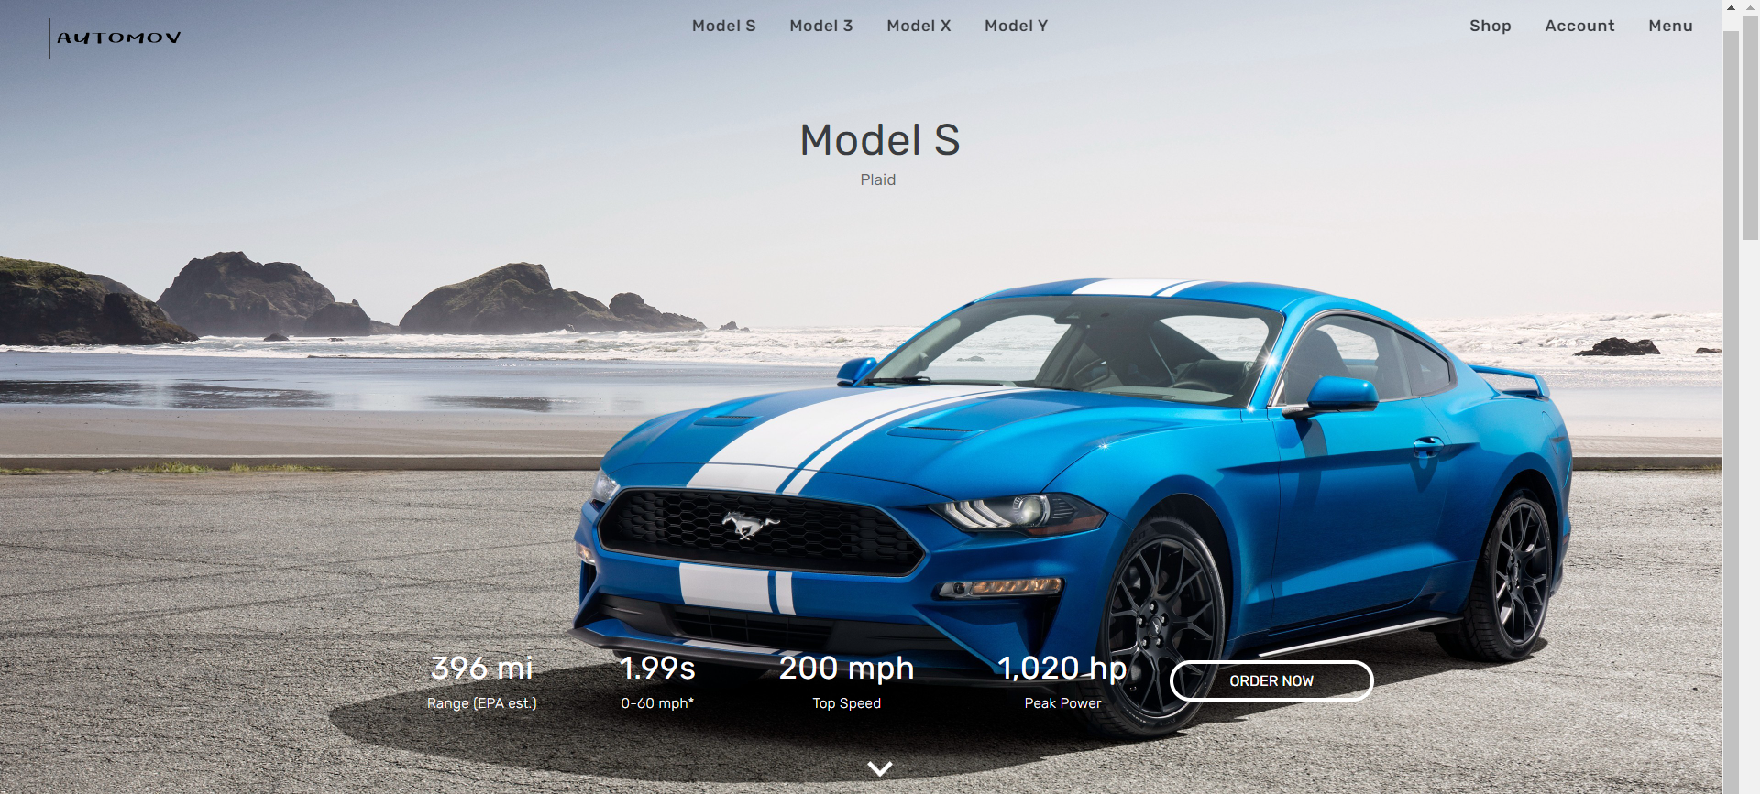
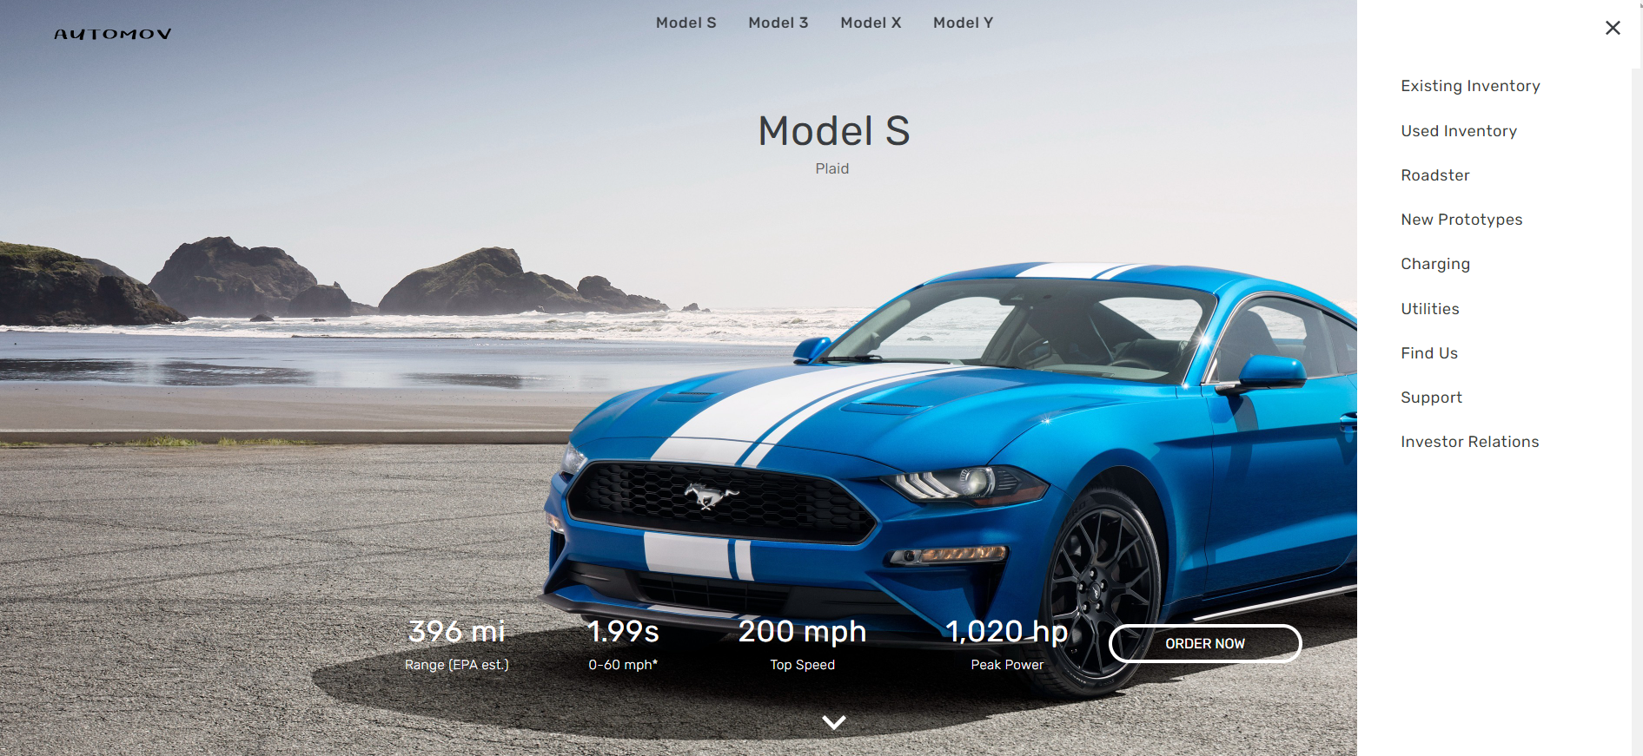
HOME PAGE
This is the Home page of the website. The image inserted of the model is in the form of a div.
Specifications of every car is displayed which include its range, top speed, power info etc.
Animation is added to this div and the image slides in when the page loads.
The header includes of Company title, Vehicles build by company namely MODEL-S, MODEL-3, MODEL-X, MODEL-Y.
The header file also contains Shop, account and Menu options which shows the various hidden features like charging, Support, Find us and many more.

Slide 6
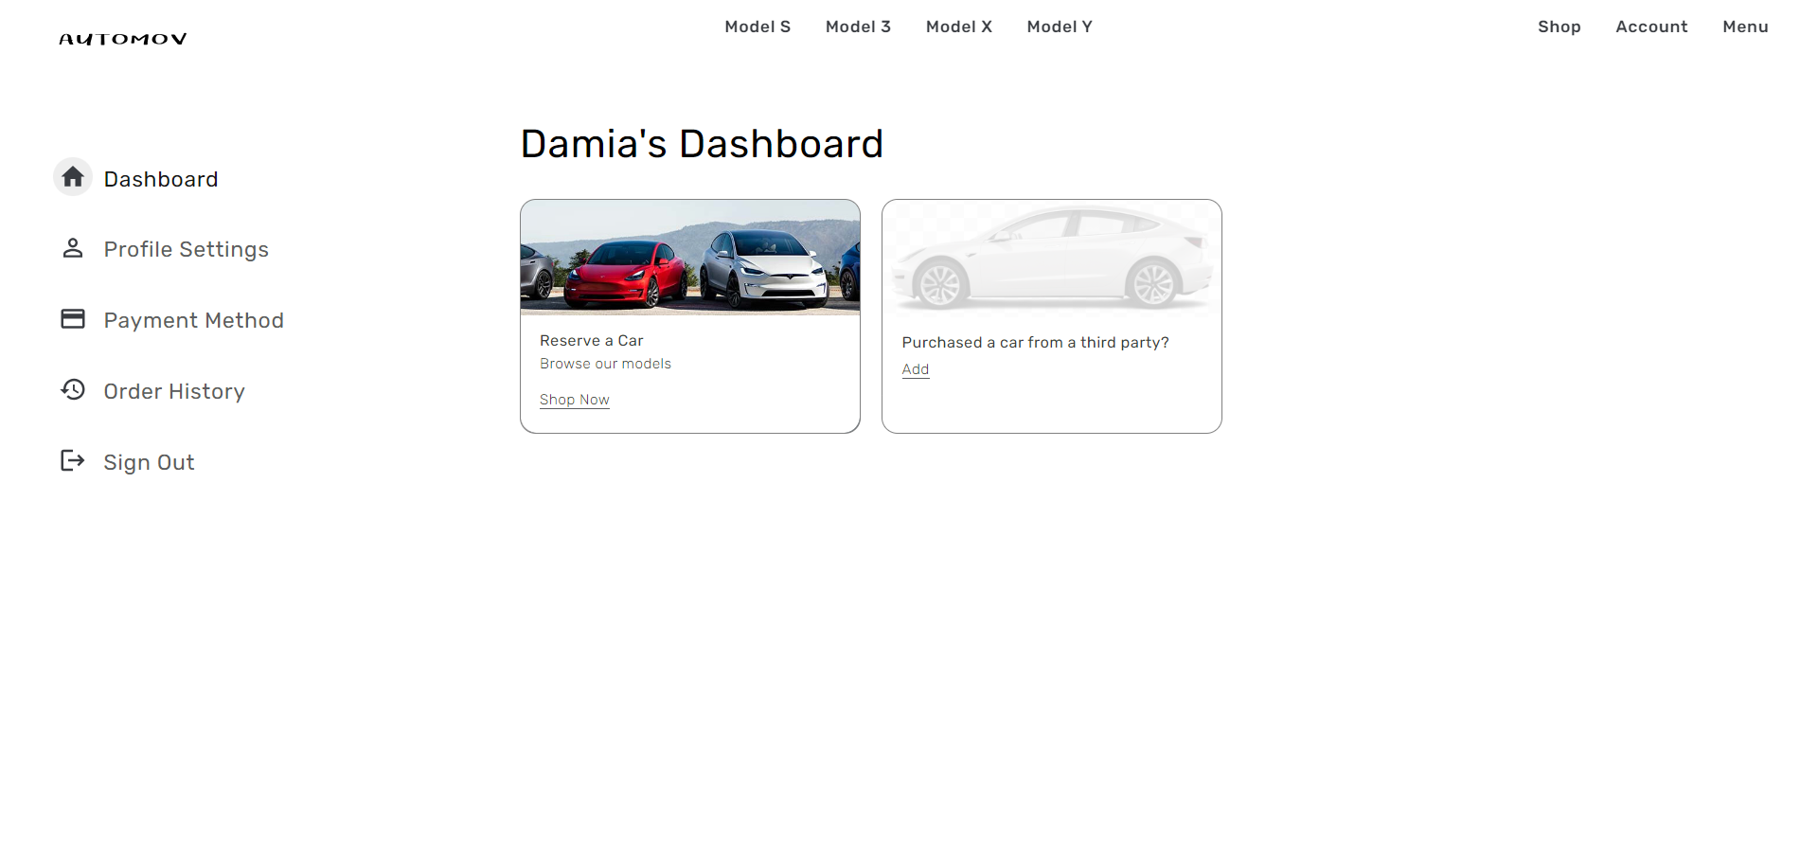
WEBSITE’S DASHBOARD
Automov’s User Dashboard displays the two main cards in the centre namely Reserve a Car and Purchase a car from a third party which is not yet utilized.
The left side of dashboard displays the various options like profile settings, payment methods etc .
Order history shows all the pervious purchases by a user.

Slide 7
CAR INTERIOR
There are no physical buttons or knobs on the dashboard, which gives the interior a clean and uncluttered look.
The front seats are comfortable and supportive, and there is plenty of legroom and headroom for both front and rear passengers. All the seats are ventilated.
All the Models have a large panoramic sunroof that lets in plenty of natural light. The touchscreen display is responsive and easy to use. It can be used to control the climate control system, the audio system, the navigation system, and other features of the car.
The Model comes standard with a rearview camera and a set of parking sensors.
There are several optional features available for the Model 3 interior, including a premium sound system, a heated steering wheel, and a 2nd row sunshade.

Slide 8
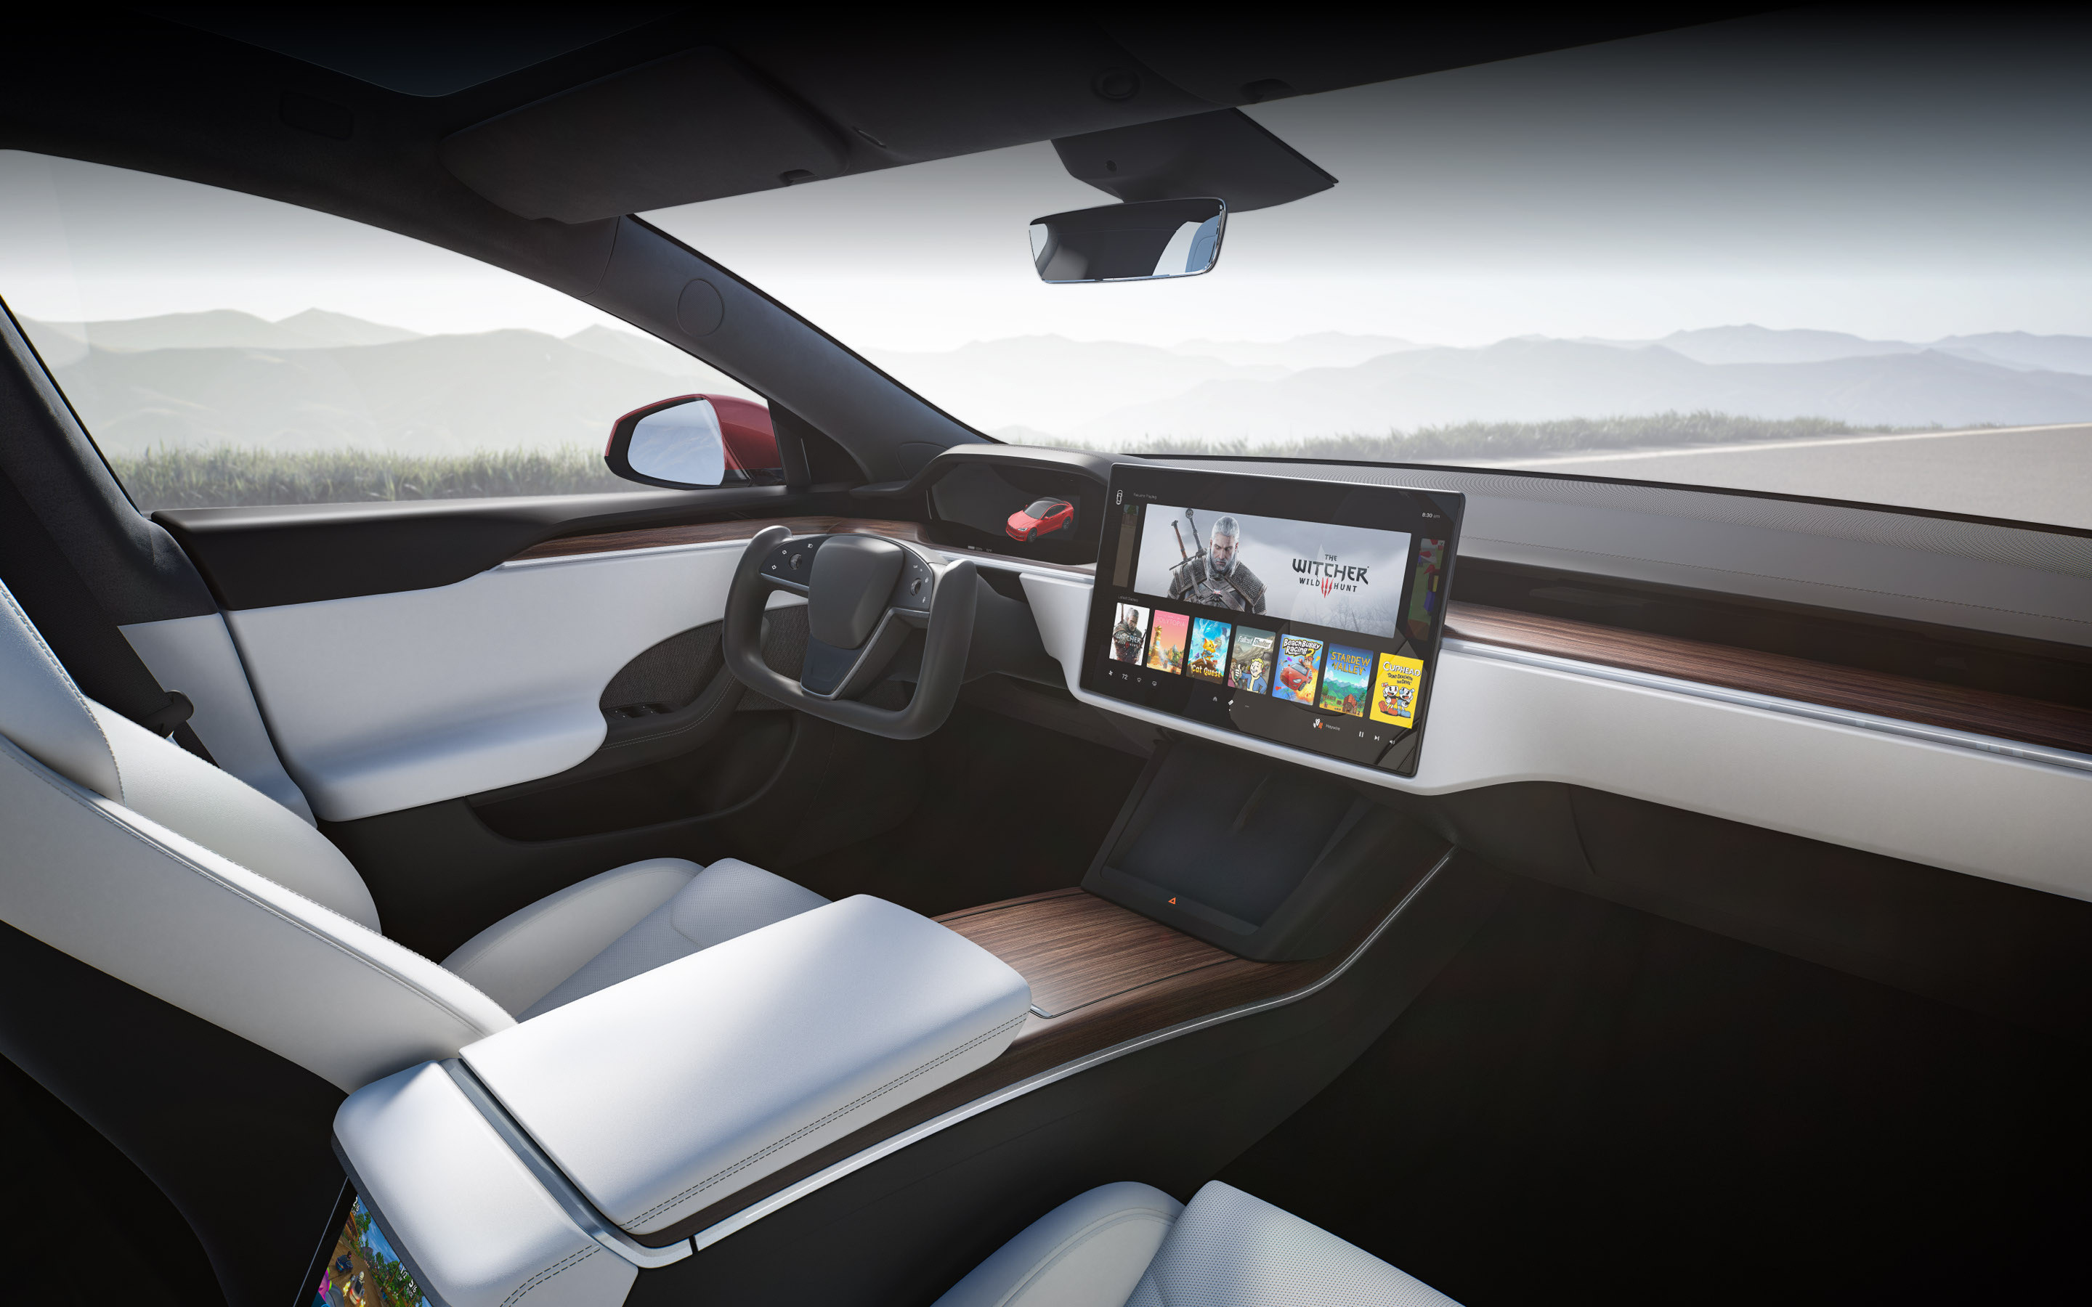
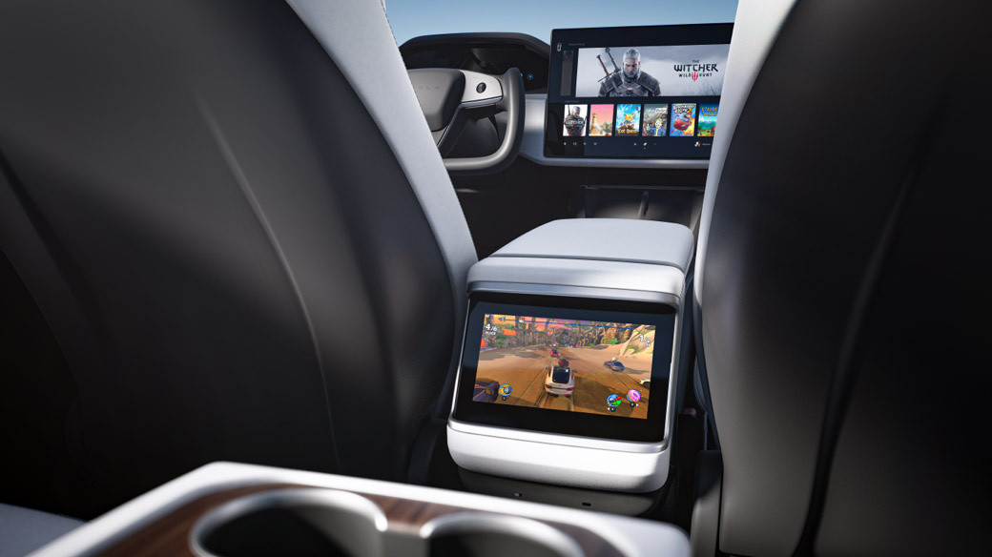
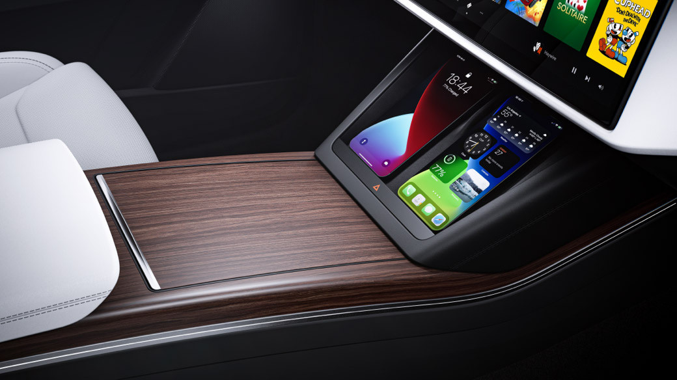
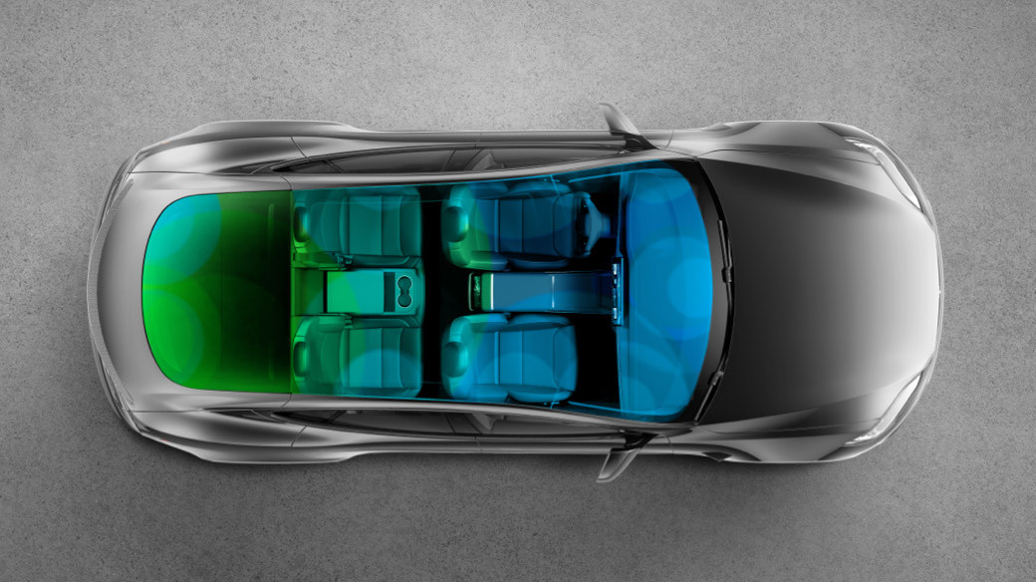
CAR MODELS

Slide 9
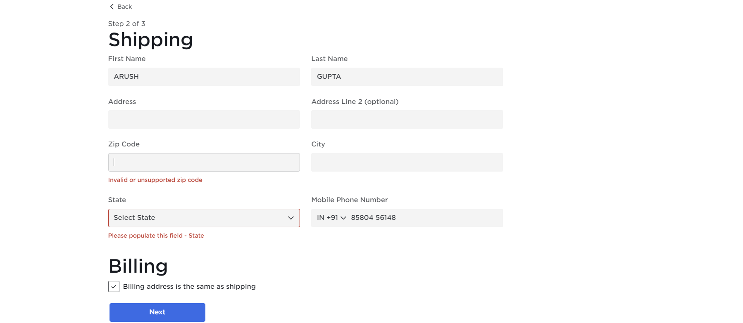
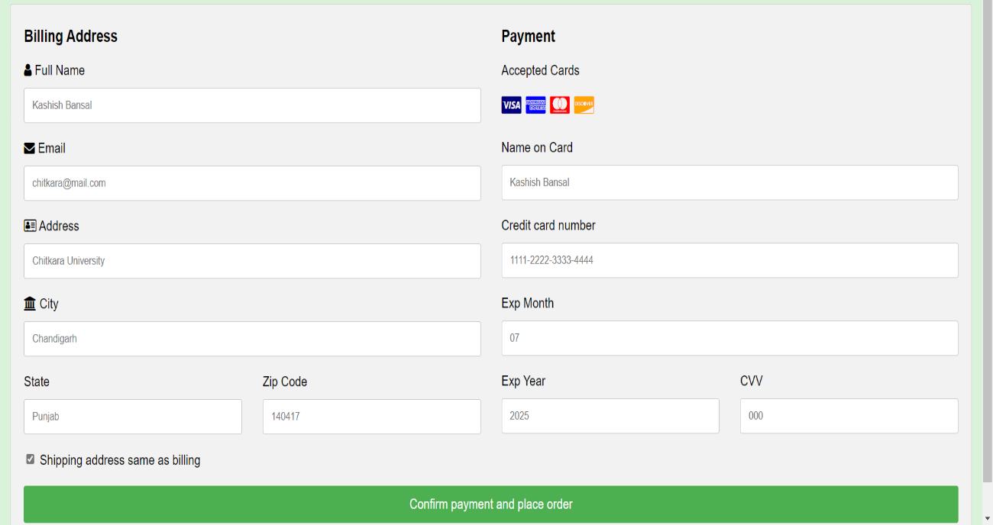
PAYMENT GATEWAY
This is the payment gateway designed via HTML form and various CSS concepts wherever necessary.
The user is asked to add the required details regarding address, pin code, email id, card details etc. After filling all these details, the user can click ‘Confirm payment and place order’.
After clicking this button, an alert box will appear informing that the order is placed successfully. After clicking ‘OK’ the user will be directed to the next Thank you page.

